Slide 1
Traffic Classification and Monitoring
Under
Dr. Saifullah
Assistant Prof, SCIS
Presented by:
A. Gayathri Devi - 17MCME19
A. Leela Srija - 17MCME18
K. Vaishnavi - 17MCME04

Slide 2
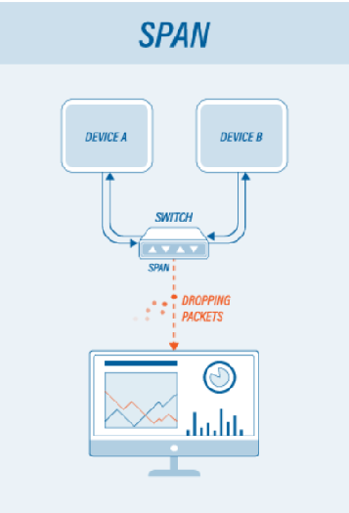
Monitoring network traffic:
There are two methods to monitor network traffic:
Mirrored ports ( SPAN - Switch Port Analyzer )
Network Tap ( Terminal port Access )
Mirrored Ports :
SPAN or roving analysis is a method for observing network traffic in a non-intrusive manner.
It is a software feature built into a network switch or a router that creates a copy of selected packets passing through device and sends them to a designated mirror port.
It is used on simpler systems to monitor multiple stations at once.

Slide 3
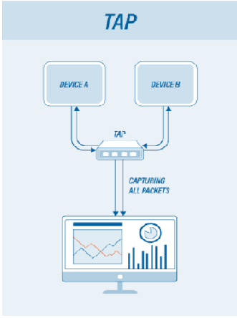
Network tap (Terminal Access Tap):
An alternative solution for long-term monitoring maybe TAP.
This is a hardware device which can passively capture traffic on a network, and is commonly used to monitor the network traffic between two points in the network.
The device can connect and disconnect to the network without disturbing it.
For visibility into the network, a TAP can be placed between the router and the switch.
Network TAPs (1:1 ratio)
Aggregation TAPs (Many:1 ratio)
Regeneration TAPs (1:Many ratio)

Slide 4

Colasoft Capsa
Introduction:
Capsa is the name of the packet analyzer developed by colosoft and there are three editions available.
The tool provides a powerful and comprehensive packet capture and analysis solution.
Traditional Network Analyzers are used to capture packets and analyze.
Portable Network Analyzer and Diagnostics tool

Slide 5
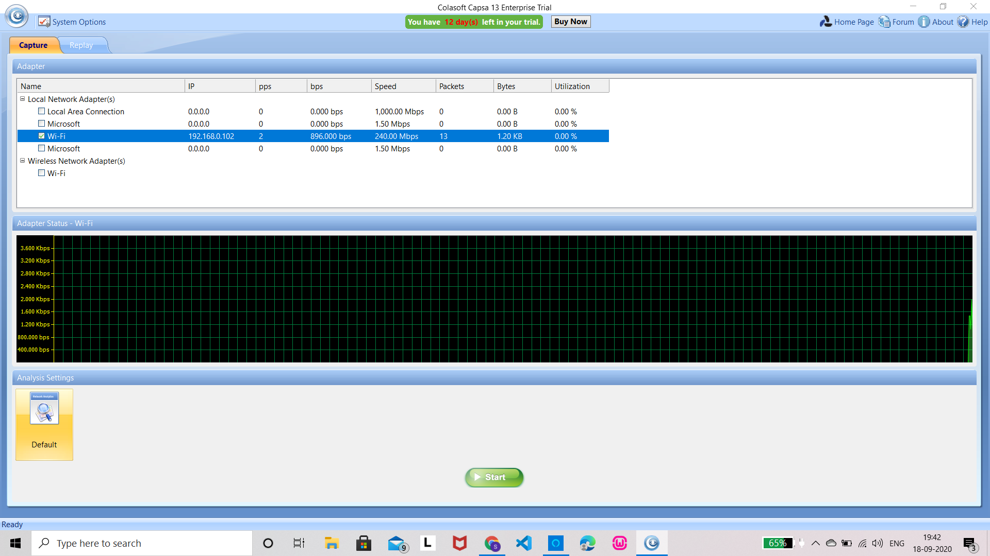
Capsa is a windows based tool. We shall use the enterprise edition and understand the features involved.
The installation and configuration are rather simple compared to other tools
The link below downloads a ‘.exe’. Execute the file and the application is ready to use
https://www.colasoft.com/download/products/download_capsa.php

Slide 6
Set-up and Configuration:
There are 3 editions of Capsa available - Capsa Standard Edition, Capsa Enterprise Edition, Capsa Free Edition.
The enterprise edition is the flagship of Colasoft Capsa packet analyzer family, it supports both Ethernet and WLAN. It does real-time packet capturing and analysis as well as past-time events analysis.
The Standard edition is an Ethernet packet analyzer. It does network monitoring, troubleshooting and analyzing.
The free edition is a freeware Ethernet packet analyzer. It is used by network geeks to learn protocols, packets and other network relating knowledge.

Slide 7
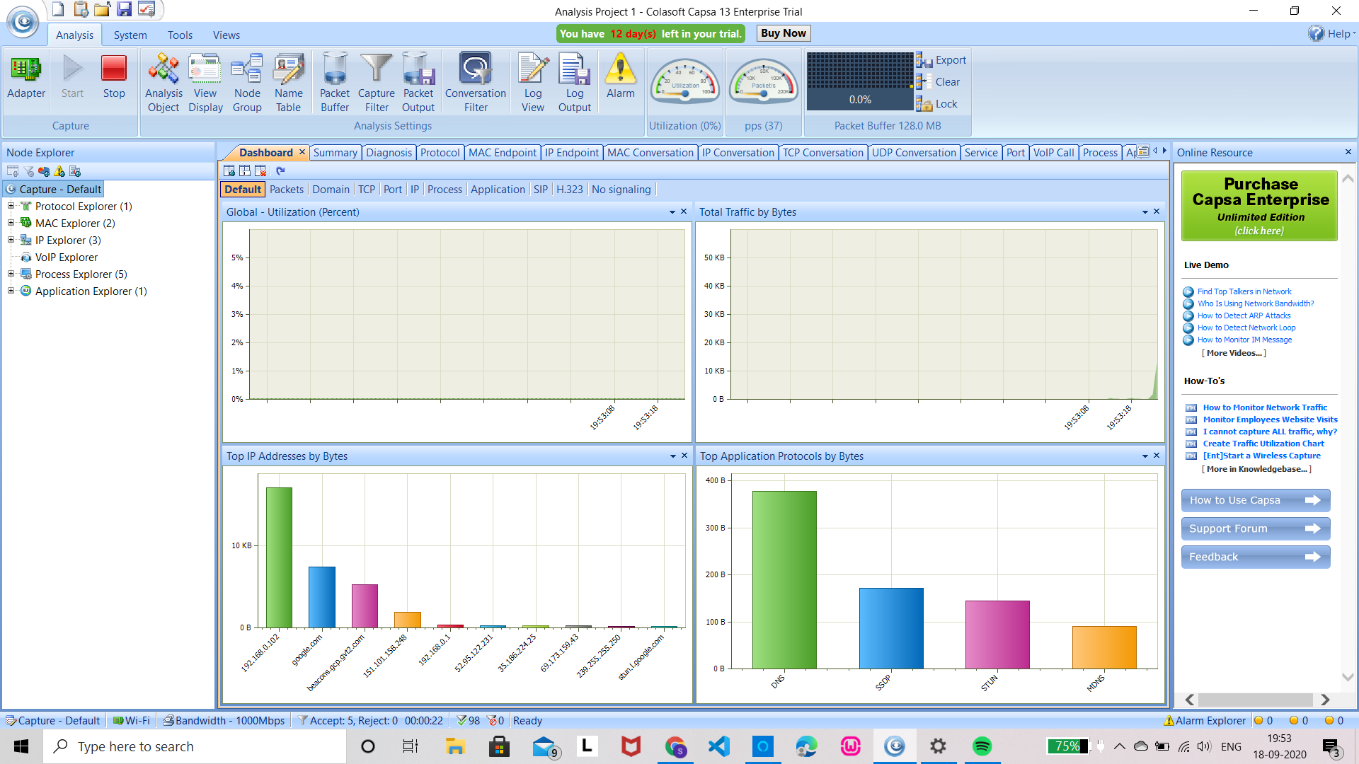
As shown the tool identifies available network adaptors. Select the one we need to monitor and press ‘Start’.
The start and stop buttons on the top left corner are provided to start and stop packet capturing and analysis.
The packets captured can also be saved to the system.

Slide 8
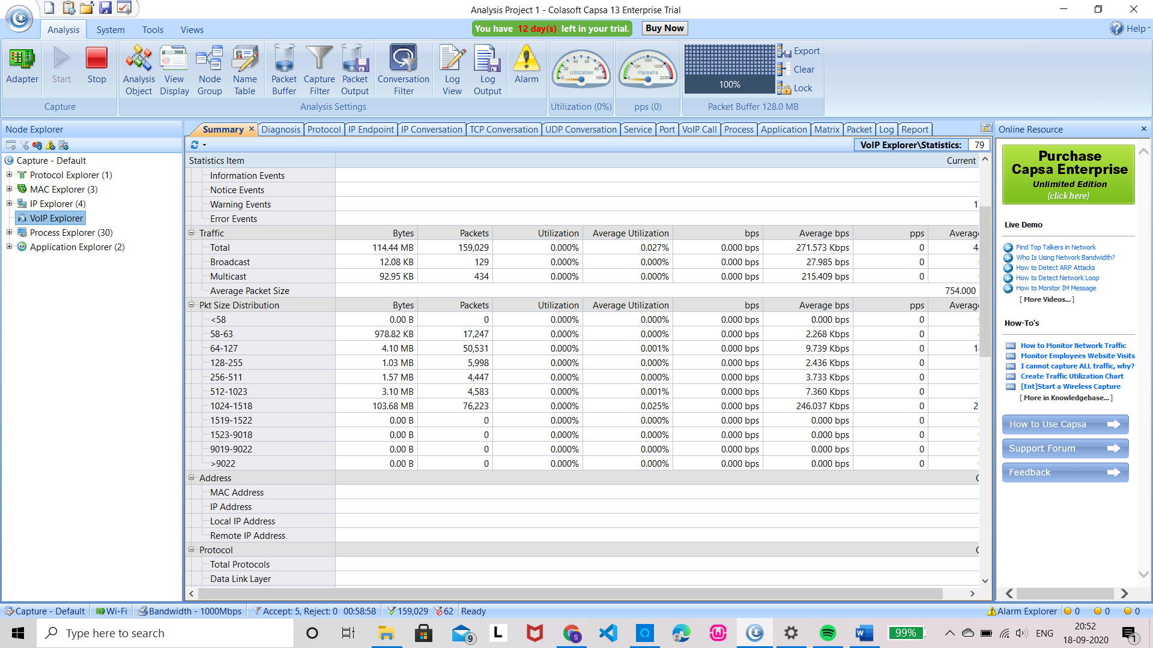
Features:
VoIP Analysis:
Capsa has VoIP(Voice over Internet Protocol) analysis module to capture and analyse VoIP calls and graphically display VoIP analysis results.
VoIP explorer groups all private and public IP addresses for VoIP calls.

Slide 9
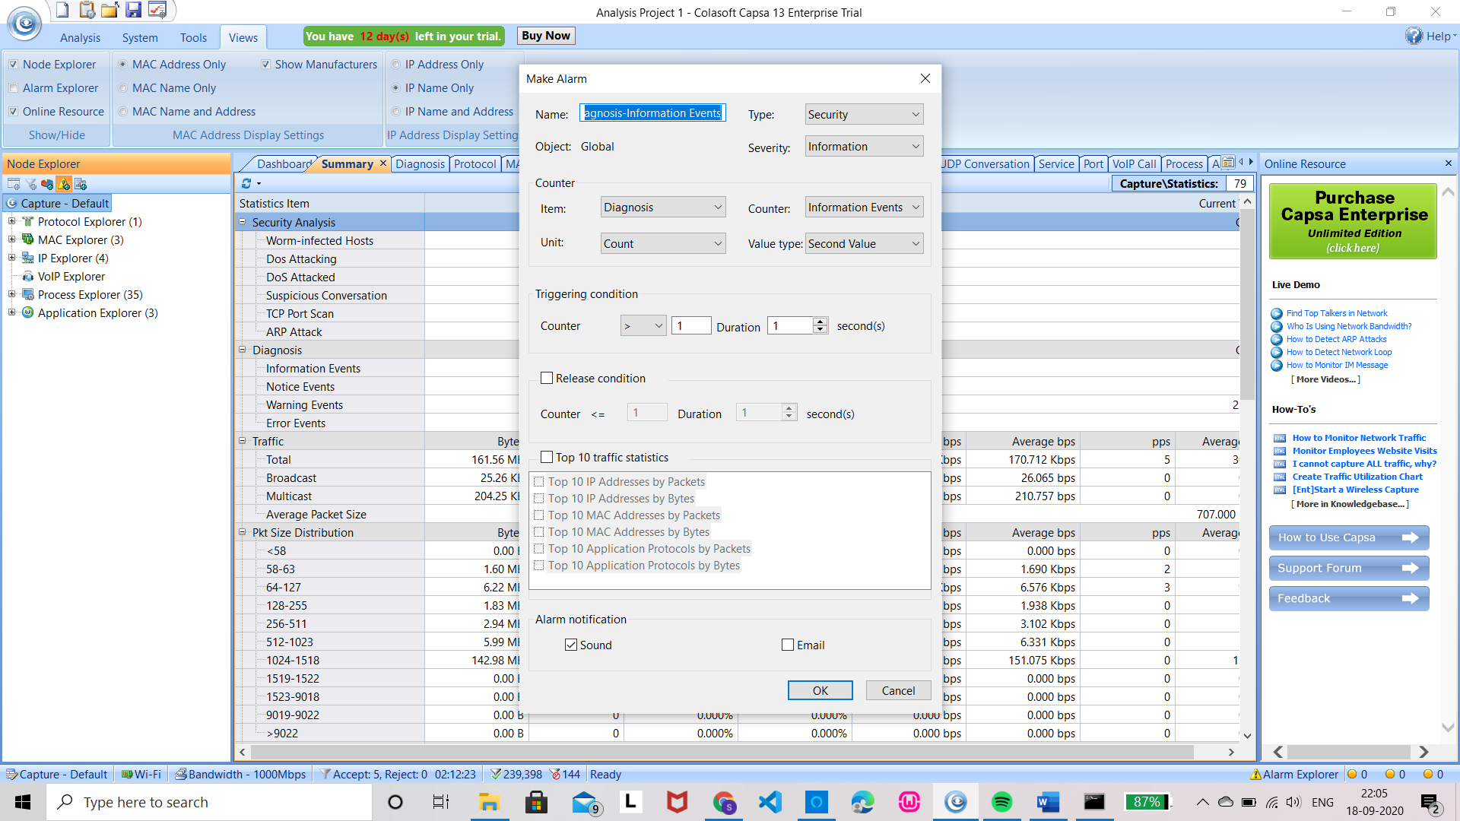
Notifying alarms by Emails & Audio:
We can create alarm rules to watch network anomalies, in case of excessive traffic throughput, excessive broadcast packets, etc
To make an alarm go to Node explorer and select ‘Make Alarm’ under it or directly select ‘Alarm’ under Analysis.

Slide 10
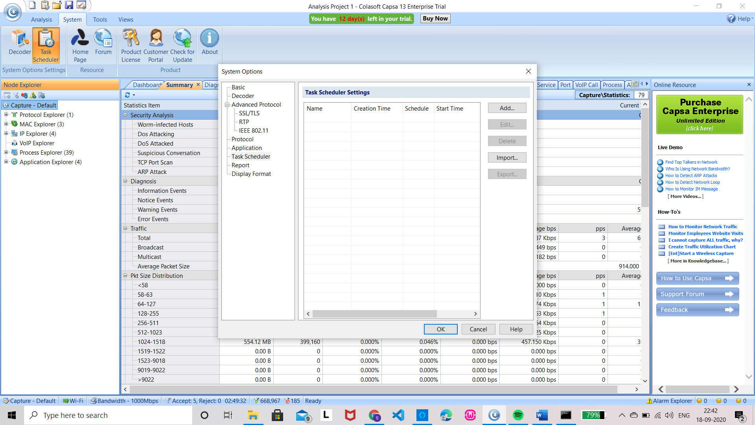
Task scheduler: Auto-run Packet Capture:
Task scheduler provides the ability to run packet capture and analysis at pre-defined automatically, which can be scheduled to run one-time, daily or weekly.
Task scheduler is found under System on the top left corner.

Slide 11
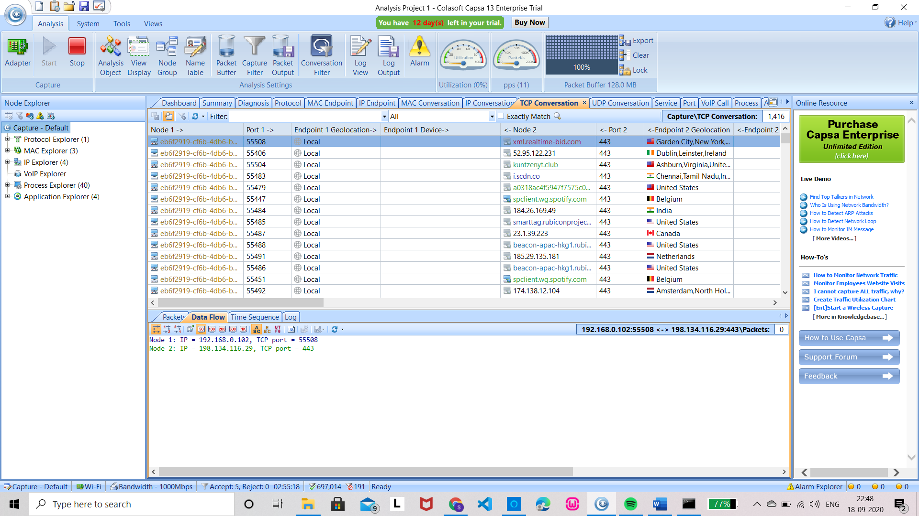
Powerful TCP flow Analysis:
TCP packets give information to help us troubleshoot networks
For example: Slow Network like slow website response, slow CRM transactions and slow downloading or uploading etc.

Slide 12
Extended Network Analysis:
The Capsa Network Analyzer performs traffic statistics as well as Security Analysis. Security Analysis detects the following network anomalies
ARP attack - The malicious source machine can be found by the MAC address
Worm activity - Worms are identified by their network activity and are located with their IP addresses
Dos attack - Capsa detects both compromised machine and machine under Dos attack
TCP port Scanning
Suspicious conversation - Suppose MSN is blocked in our network and HTTP port 80 is open for web browsing. A malicious user could change MSN port to 80 to chat with others.

Slide 13
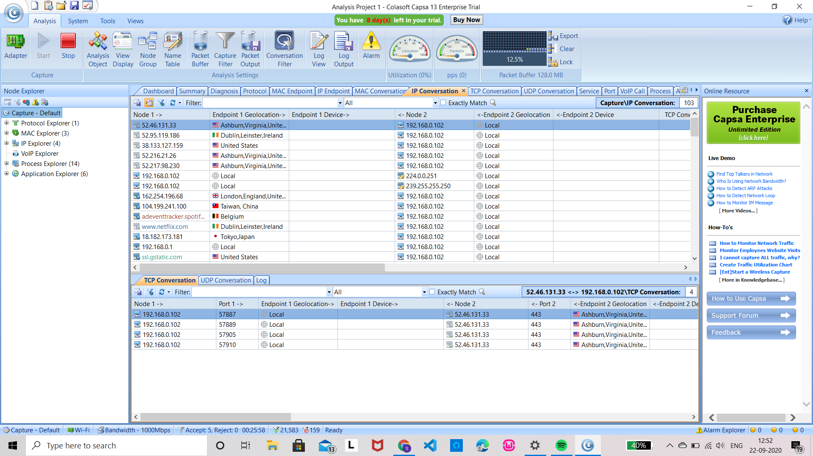
Versatile Traffic and Bandwidth Statistics:
Monitor Network Traffic in the Dashboard tab
Monitor Network traffic in the summary tab
Monitor Network traffic in the physical Endpoint and IP endpoint tabs
Monitor network traffic in the protocol tab
Monitor Network traffic in the conversation tabs
Monitor Network traffic in the Matrix Tab

Slide 14
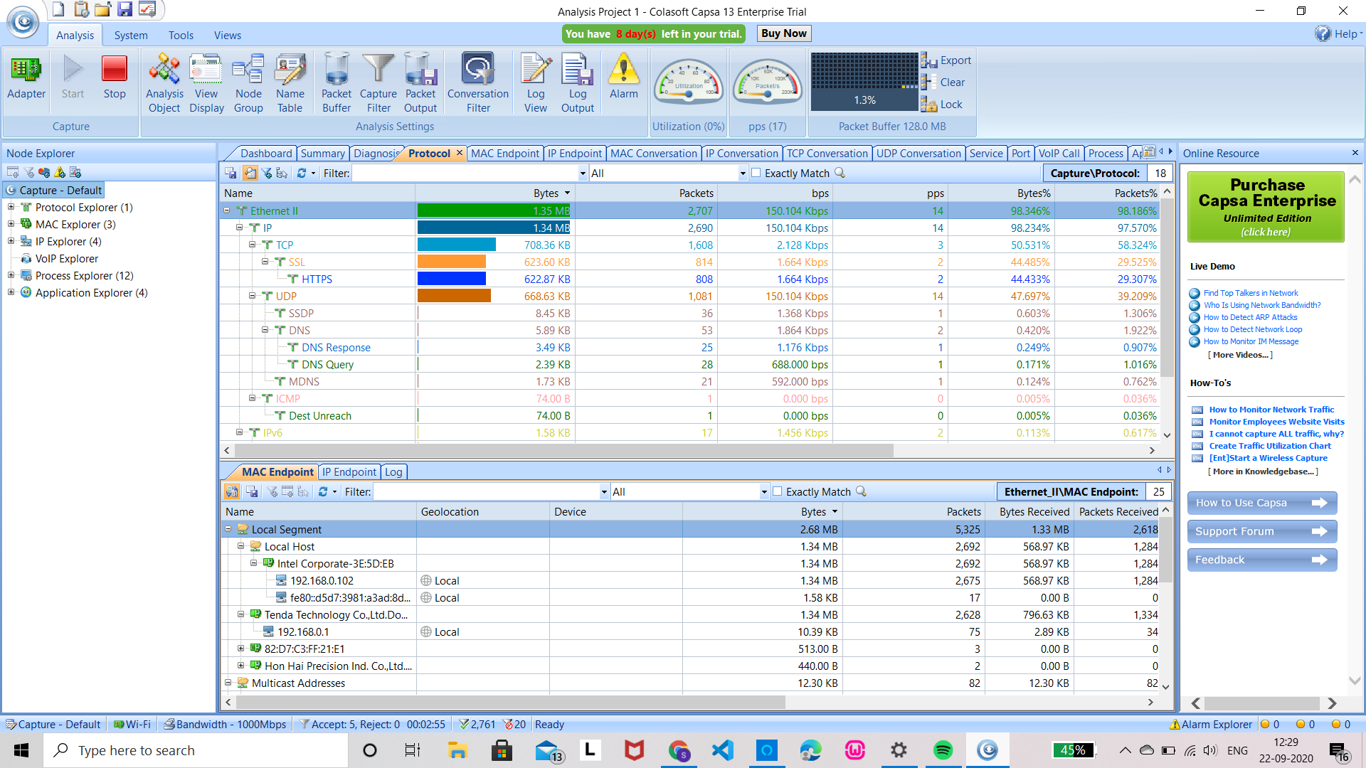
Advanced Network protocol Analysis
Protocol is a convention or standard that controls or enables the connection, communication, and data transfer between two computing endpoints.
Analyze Protocols with Capsa - network application which has generated the largest traffic
Comprehensive Protocol Statistics in the Protocol Tab - protocols detected are listed with detailed traffic

Slide 15
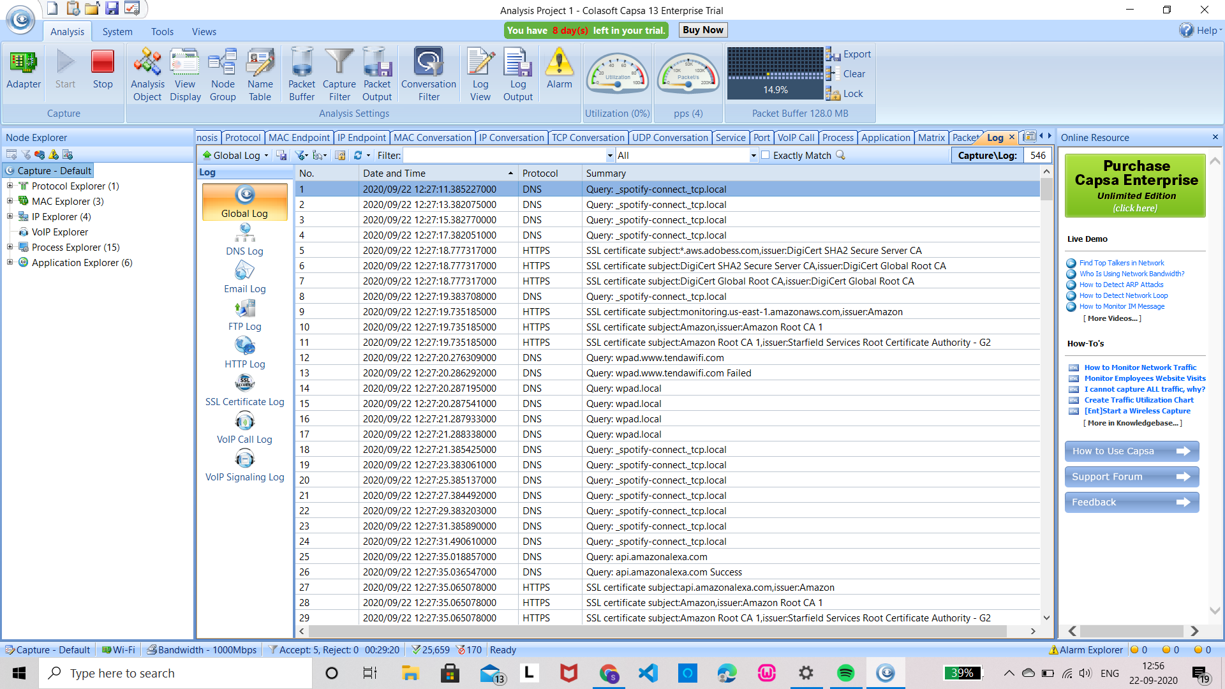
Multiple Network Behaviour Monitoring:
The logs in Colasoft Capsa can record global or scope-specific network events, containing 9 types of log primarily generated by the advanced analyzers: DNS analysis, Email messages, FTP transfers, HTTP webpage visits, VoIP calls, VoIP signalings and activities of 3 instant messengers: ICQ activities, MSN activities and Yahoo Messenger activities.

Slide 16
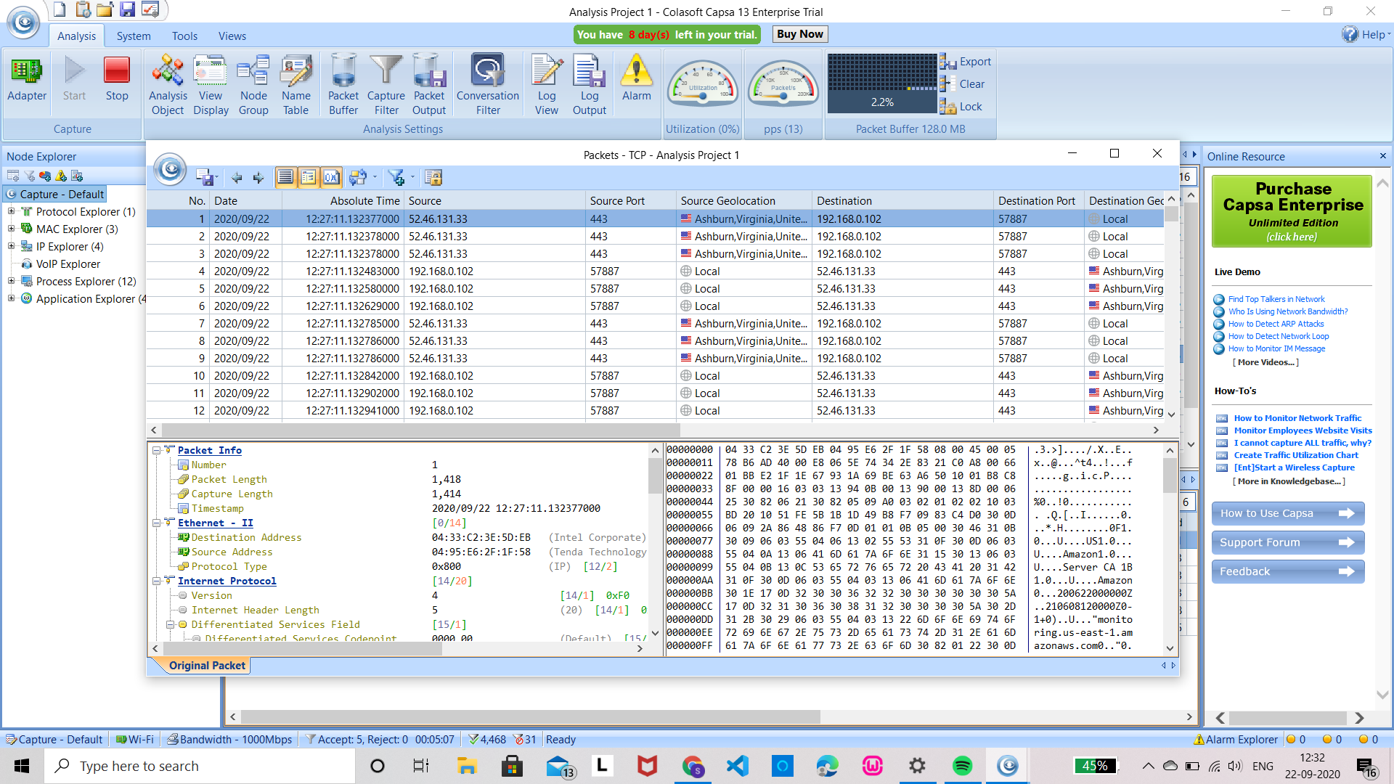
Drilldown on a Single Protocol - Capsa’s Node Explorer window allows network administrators to carry out drill down analysis on a single protocol

Slide 17
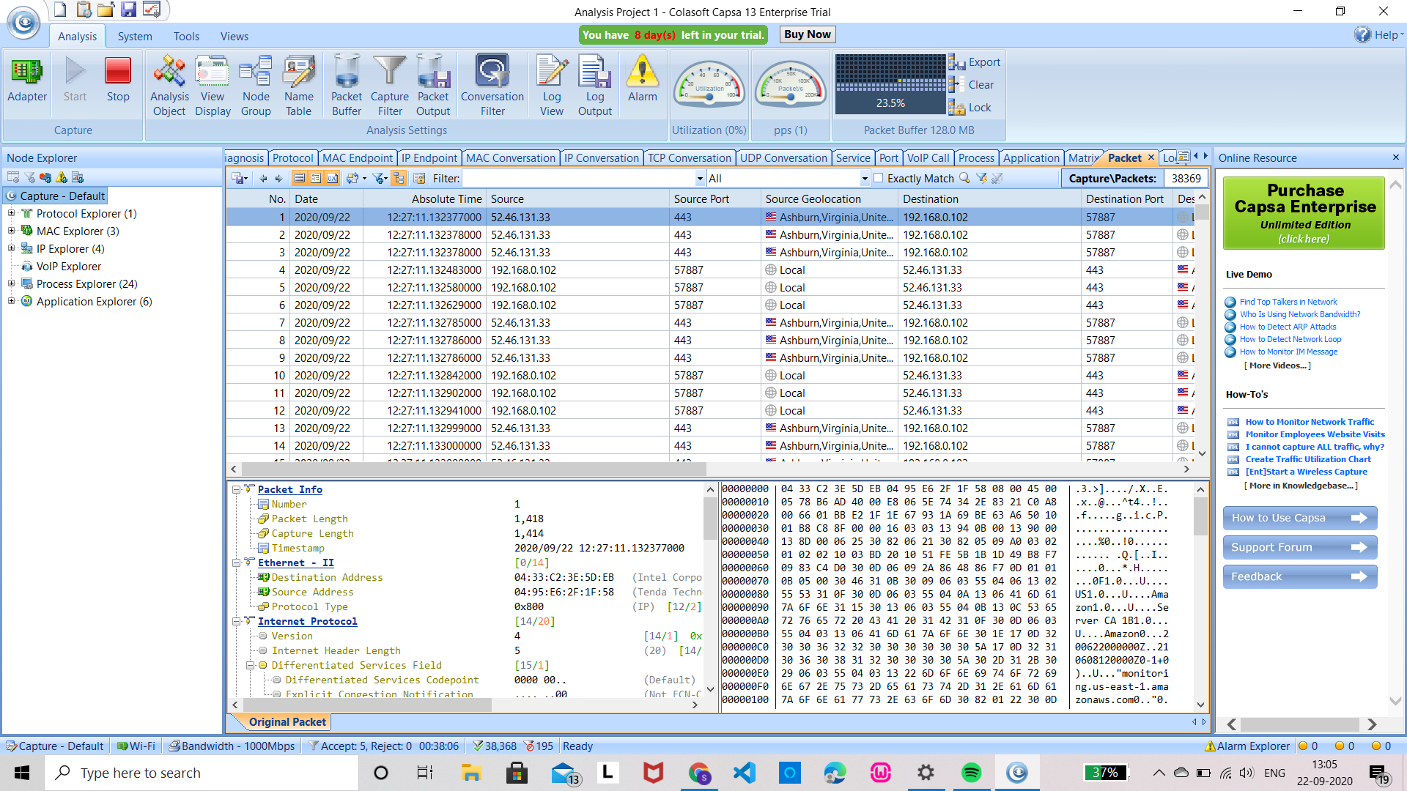
Packet Decoding
Capsa is able to capture all network packets transmitted on network and displays detailed packet decoding information in Hex, ASCII and EBCDIC.
Packet list - table offers the list of packets captured from the node selected in the Node Explorer
Packet decoding information helps troubleshooting network to track down security vulnerability

Slide 18
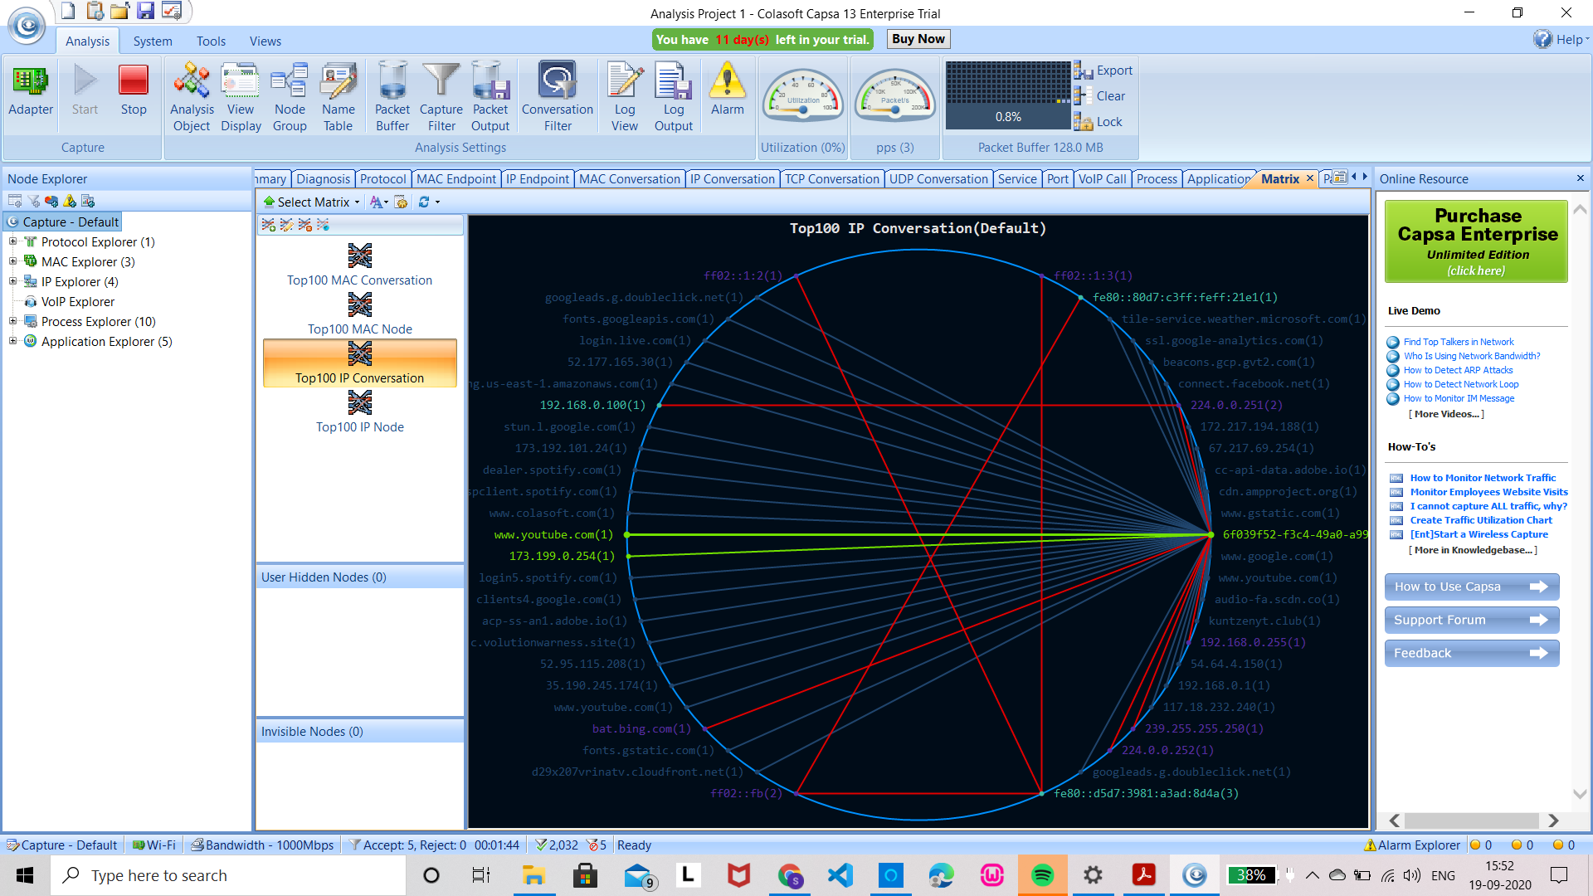
Visualized Connections in Matrix:
The matrix tab visualizes all the network connections and traffic details in a single graph. The nodes around the elongated ellipse display the hosts in the network; the weight of the line between nodes indicates the traffic, and the color indicates status

Slide 19
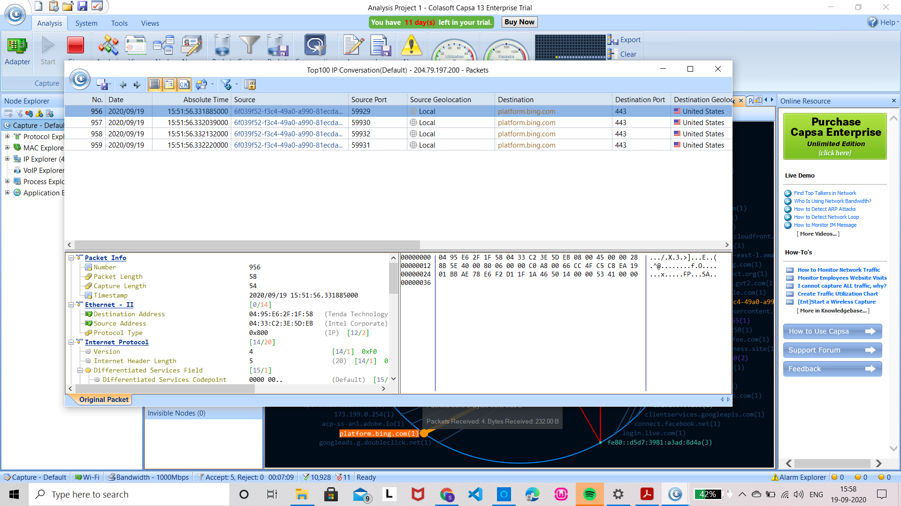
Clicking on a single node, administrators can view its detailed traffic information.

Slide 20

ntopng
ntopng is based on libcap (a portable C/C++ library for network traffic capture)
Comes in 4 versions - Community, Professional, Enterprise M, Enterprise L.
Provides an intuitive, encrypted web user interface for the exploration of realtime and historical traffic information.
High-Speed Web-based Traffic Analysis and Flow Collection

Slide 21
Main Features
Shows real time network traffic and active hosts.
Sorts network traffic according to many criteria.
Identifies Top talkers (senders/receivers).
Monitors and reports live throughput, network and application latencies, Round Trip Time (RTT), TCP statistics (retransmissions, out of order packets, packets lost), and bytes and packets transmitted.
Geolocate and overlay hosts in a geographical map.
Alerts engine to capture anomalous and suspicious hosts.

Slide 22
Main Features Contd.
Discovers application protocols (Facebook, YouTube, BitTorrent, etc) by leveraging on nDPI ( its own GPL DPI toolkit ).
Characterises HTTP traffic by leveraging on characterisation services provided by Google and HTTP Blacklist.
Continuous monitoring of SNMP devices.
Interactive historical exploration of monitored data exported to MySQL.
Identity Management, including correlation of VPN users to traffic.
Can be integrated with other softwares and tools.

Slide 23
Tech Specifications
Platforms
Unix
Linux
Mac OS X
Windows x64
ARM
Web GUI
Available through any HTML5-ready web browser
SSL/HTTPS support
Protocols
Ethernet
IPv4/IPv6
TCP/UDP/ICMP
DHCP/BOOTP/NetBIOS/DNS…
GRE
250+ Layer-7 application protocols supported by nDPI
…and many more

Slide 24
Installation
Go to https://www.ntop.org/get-started/download/
Choose the desired package or download the source code from their Github page ( The community version of ntopng is free to use and open source. )
If downloading packages, select the operating system and the build type (stable build or nightly build)
Add the repository and install ntopng

Slide 25
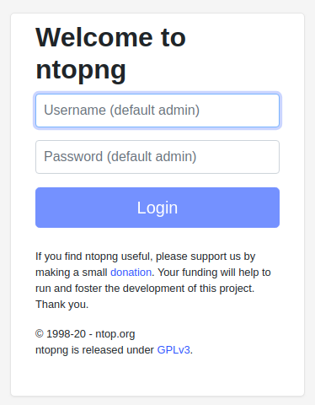
Configuration and Usage
Open the configuration file located at /etc/ntopng.conf
Uncomment and specify the port on which ntopng will listen for the web-UI. (ntopng will try to auto-detect the interfaces)
Run ntopng command in terminal with sudo privileges.
Open the web browser and type the URL http://localhost:3000 or http://your-server-ip:3000 (default port number in configuration file is 3000) and login.
Explore

Slide 26
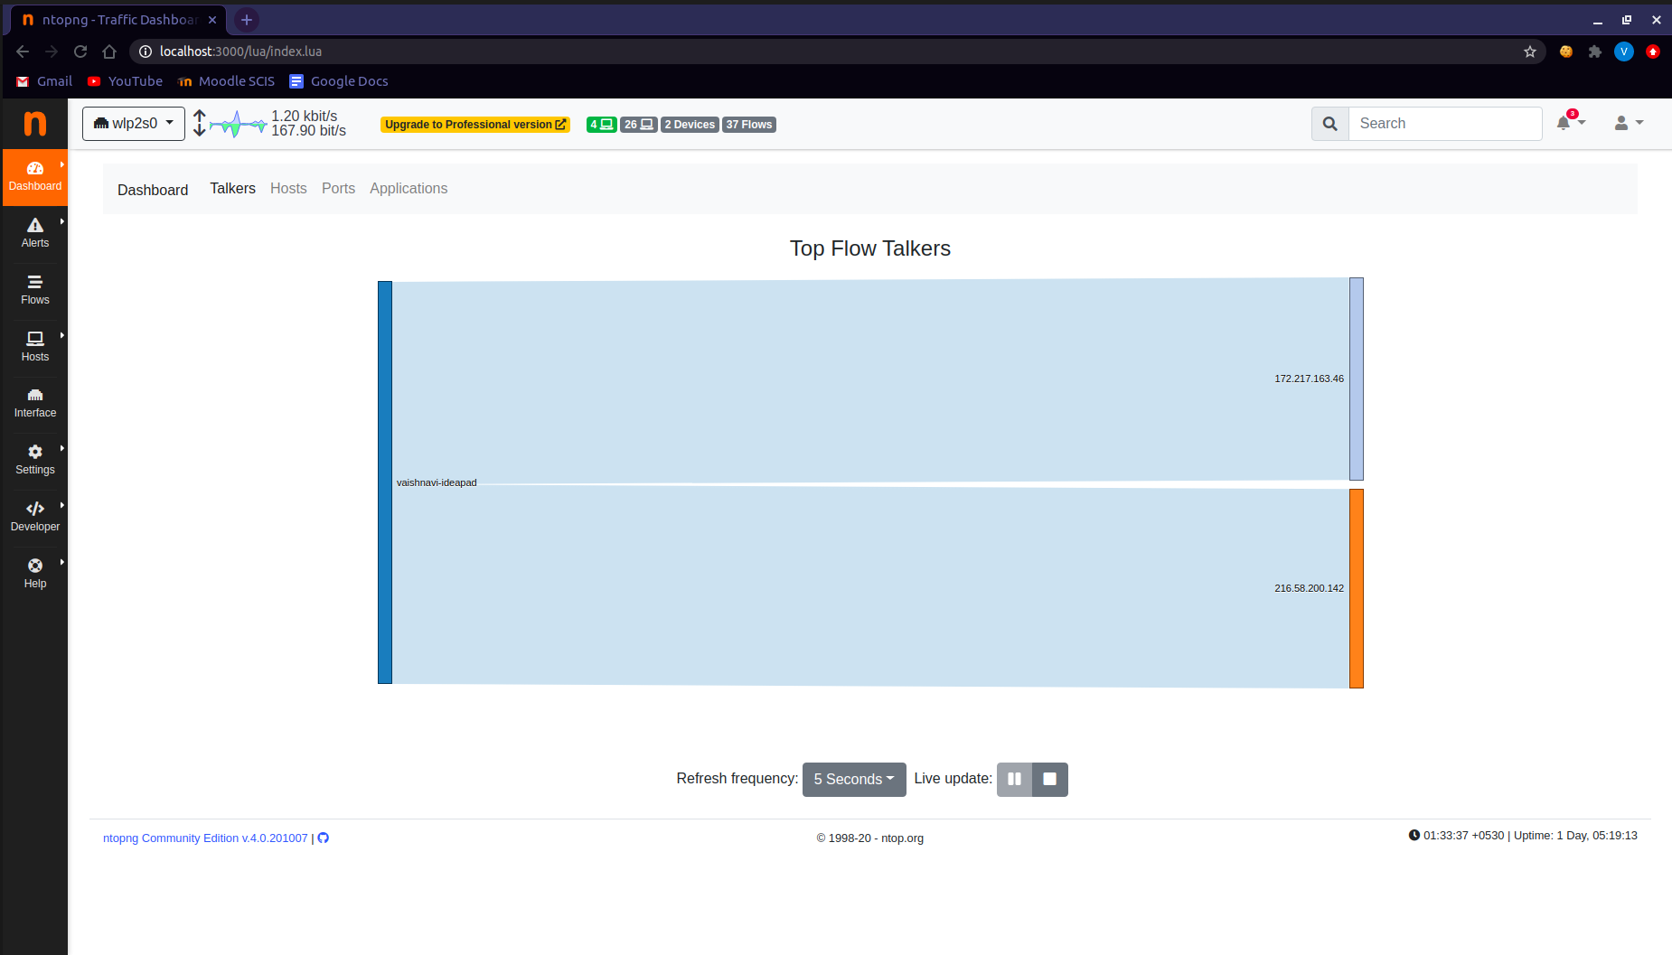
Traffic Dashboard (Community version)

Slide 27
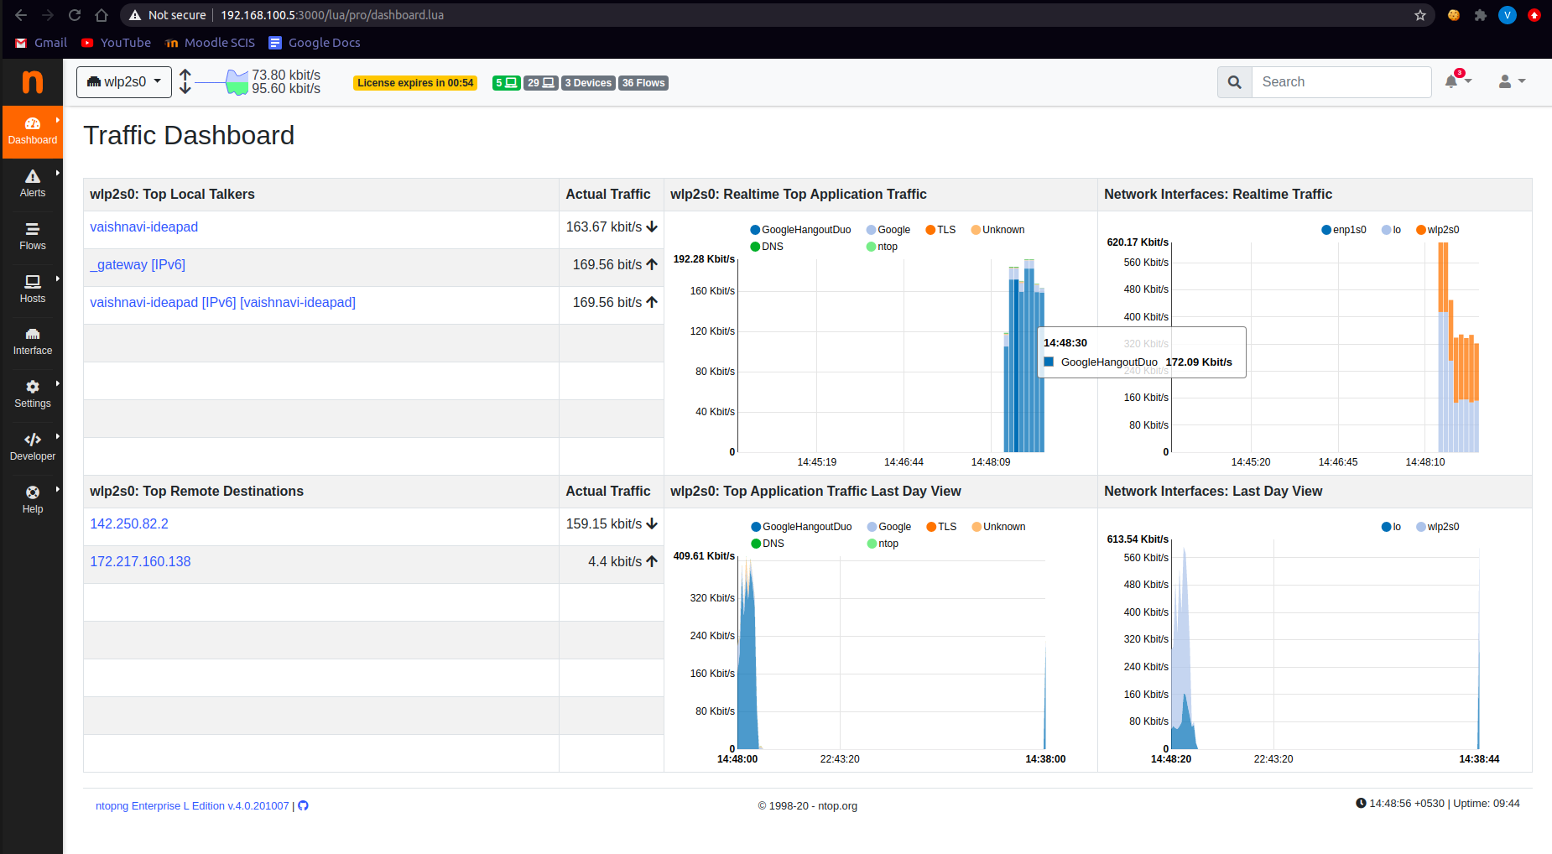
Traffic Dashboard (Professional version)

Slide 28
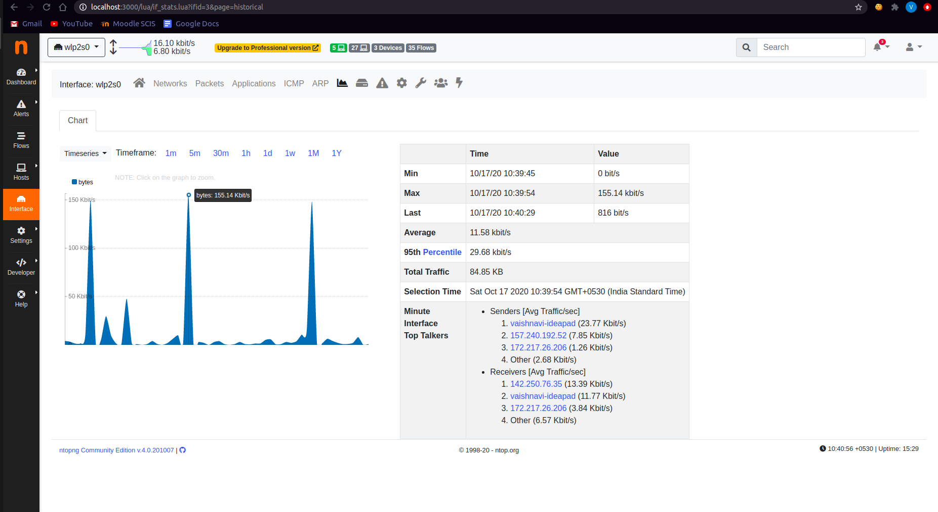
Interface chart (Community version)

Slide 29
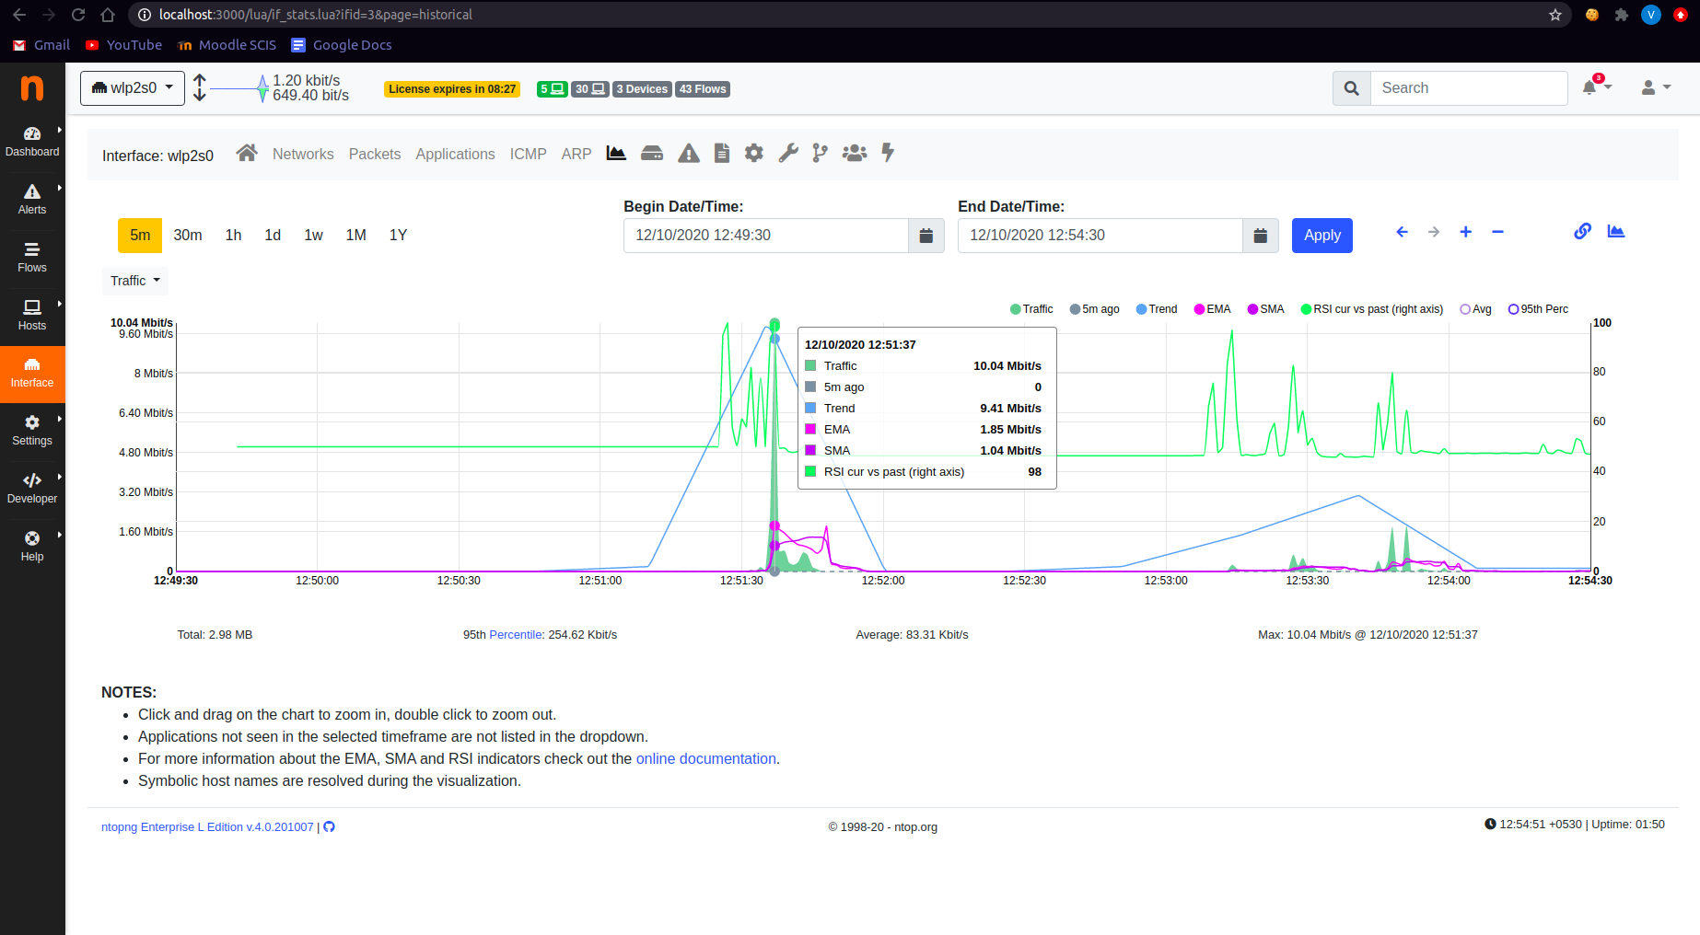
Interface chart (Professional version)

Slide 30
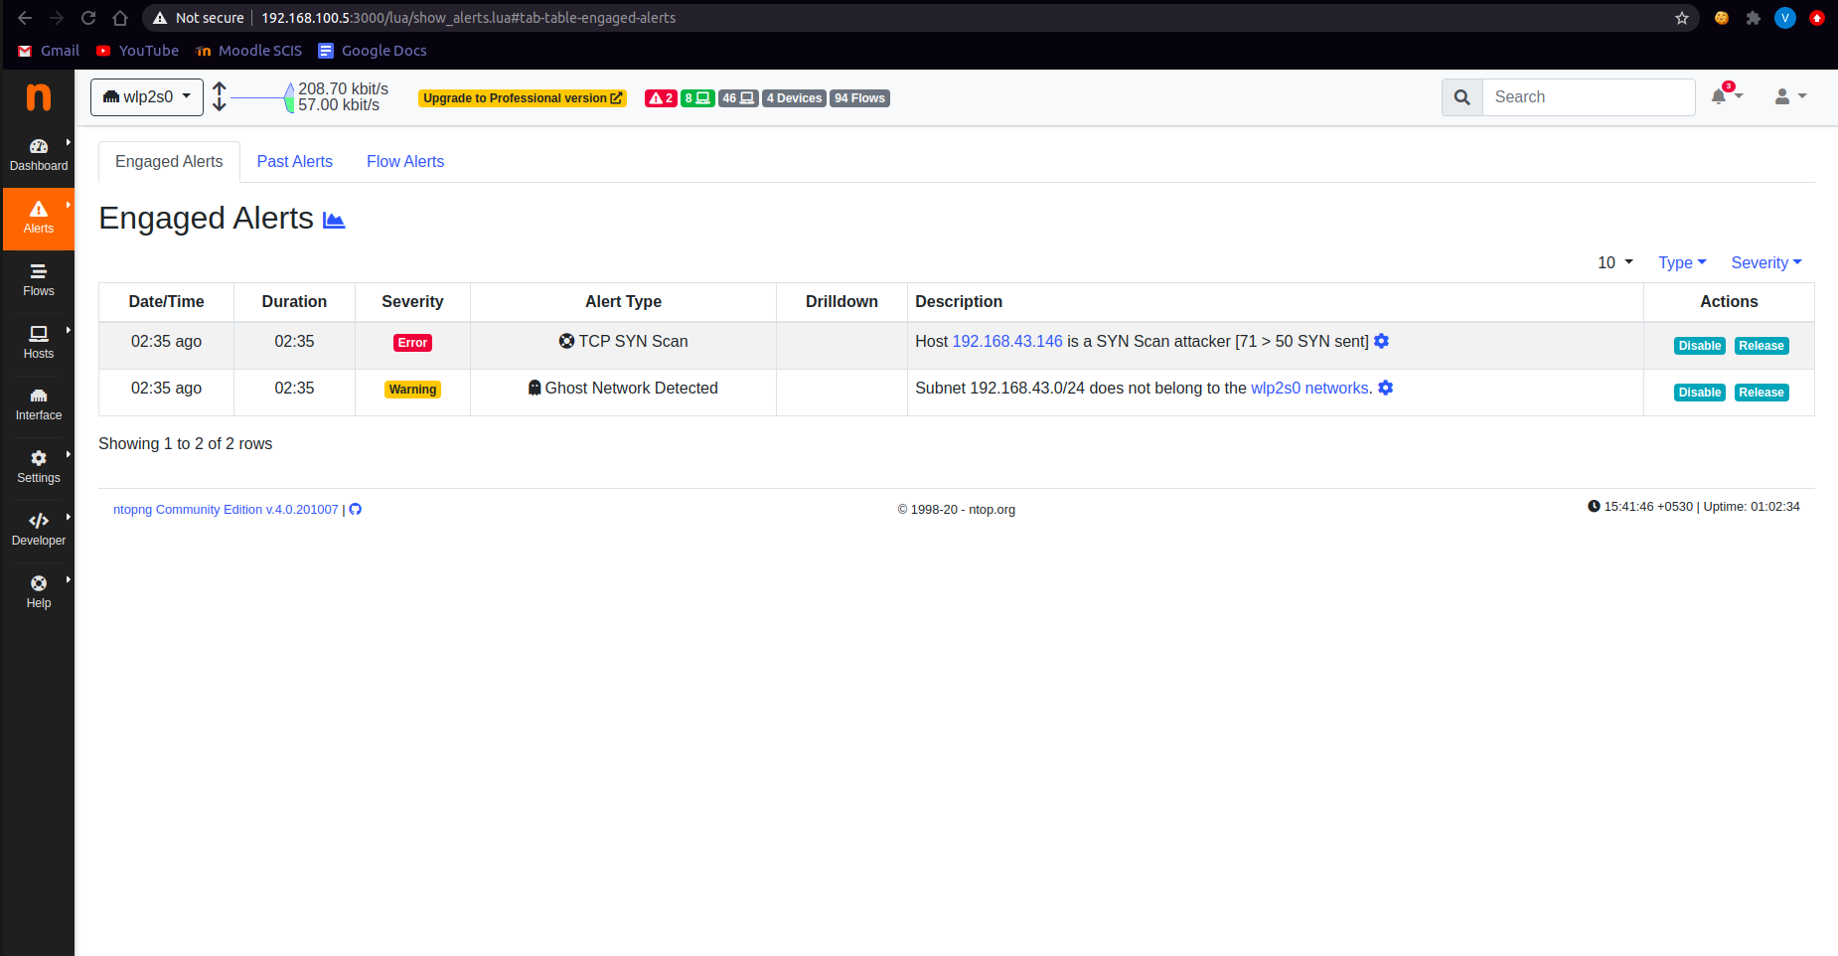
Alerts dashboard (Community version)

Slide 31
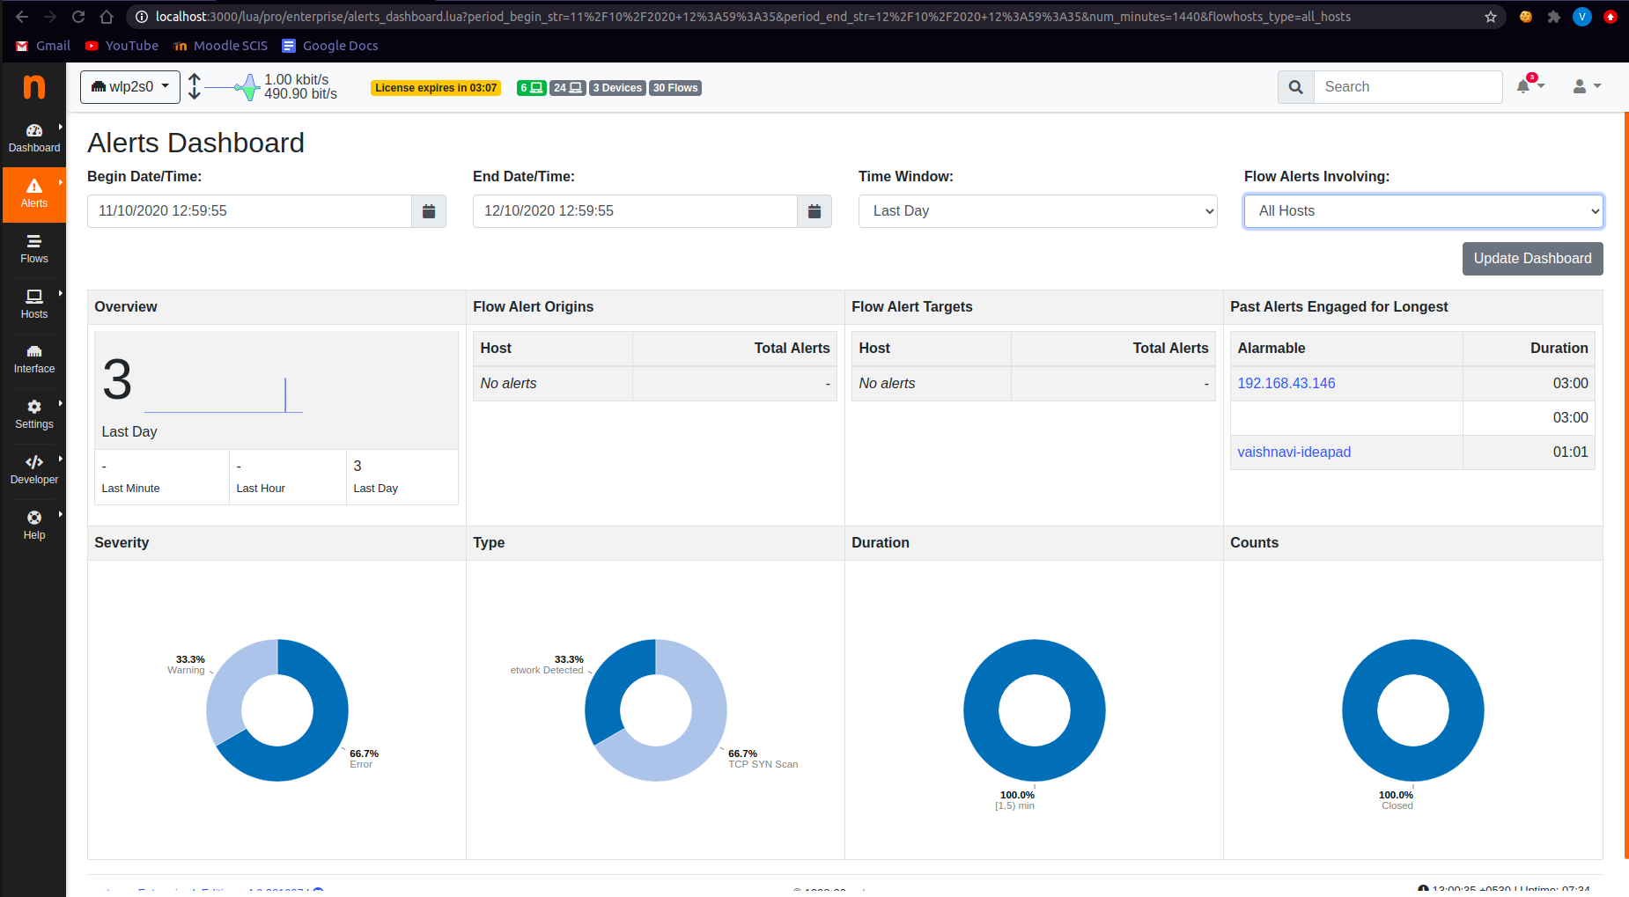
Alerts dashboard (Professional version)

Slide 32

Nagios
A tool that monitors systems, networks and infrastructure.
Nagios was originally designed to run under Linux.
Nagios XI is a toolkit using Nagios Core as the back-end.
Enterprise Server and Network Monitoring Software

Slide 33
Nagios
Nagios known as nagios core is an open source application that monitors systems, networks. Which is compatible with RHEL, CentOS, Ubuntu, Debian Linux distributions and on Virtual Machines
A network flow data analysis solution for providing organizations with a view into all network traffic.
Nagios Core serves as the basic event scheduler, event processor, and alert manager for elements that are monitored. It features several APIs that are used to extend its capabilities to perform additional tasks, is implemented as a daemon written in C for performance reasons, & is designed to run natively on Linux/*nix systems.
Home dashboard provides an at-a-glance view of critical netflow or sflow data sources, server system metrics, and abnormal network behavior for quick assessment of network health.

Slide 34
Nagios Network Analyzer
Nagios Network Analyzer is a netflow, sflow data analysis software. Nagios is an open source monitoring system designed to run on the Linux operating system and can monitor devices running Linux, Windows and UNIX operating systems
Network Analyzer provides a central view of your network traffic and bandwidth data as well as potential network compromises. It is available both on windows and linux systems.
It can monitor the availability of nodes and their uptime.
It can also watch on the response time of every node.
It provides reports and visual representations.
It performs network monitoring for issues like crashed servers, etc

Slide 35
Installation & Configuration
Navigate to nagios core page https://www.nagios.com/products/nagios-xi/ where the specifications and prerequisites are mentions for different operating systems.
The installation guide gives a step by step procedure of for integration of Nagios network analyzer with Nagios XI.
Admin get access to System Extensions
Under Core Components add on Network Analyzer
Need to add each server for which the access is to be enabled

Slide 36
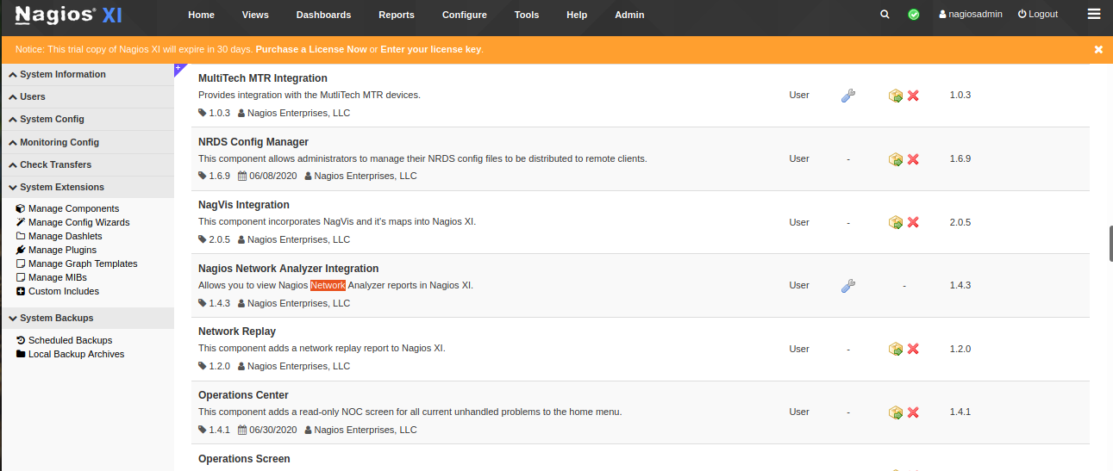

Slide 37
Features
Dashboard - High level overview of sources, checks, network flow data
Security and Reliability - capable of alerting users when suspicious activity takes place.
Advanced Visualization - in-depth insights on network traffic, bandwidth.
Custom Application Monitoring - monitor network usage of specific applications.
Specialized views - track the specific subnets of network flow information and maintain historical network flow data.
Automated Alert System - Receive alerts when abnormal activity takes place.
Seamless Nagios XI system - to see network analyzer report and communication.
Advanced User Management - User options allow IT teams to work together efficiently.

Slide 38
Adaptability
Create a Network analyzer environment.
Admins can apply views and queries to multiple sources.
Add-on capabilities allow users to push SNMP notifications to monitoring and SNMP trap management systems.
Network analyzer adapts to your environment for free implementation process.
Integrate with the website to get complete data flow.

Slide 39
Bandwidth Utilization Calculator
A customizable bandwidth utilization calculator is included allowing reports to be created to summarize bandwidth utilization per source, IP.
Network Analyzer can perform DNS resolution of host names such as facebook.com or youtube.com, and will allow you to abstract your queries in that fashion.

Slide 40
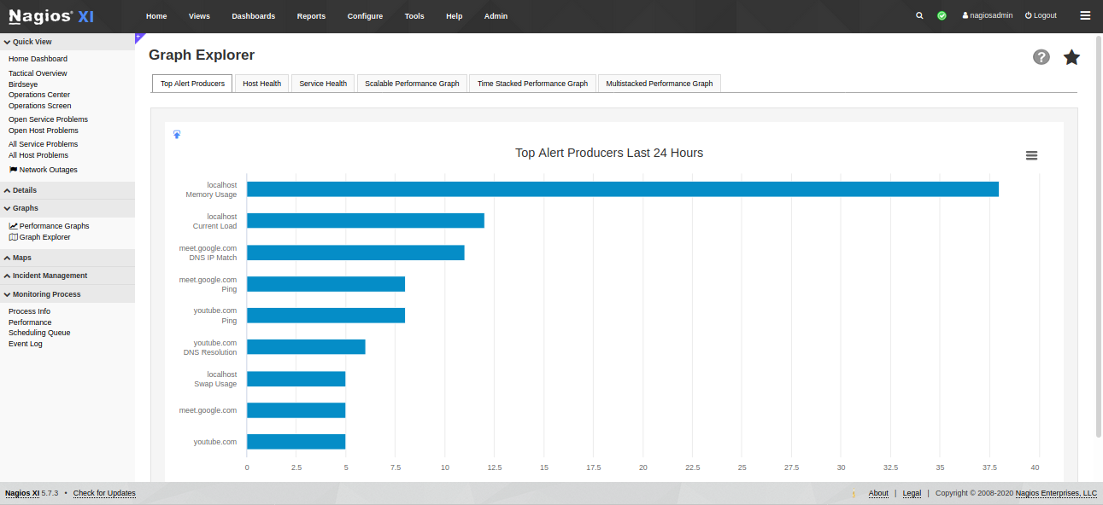

Slide 41
Bandwidth Monitoring
Nagios provides complete bandwidth monitoring of switches and Routers via SNMP. Switches and routers can be monitored via SNMP v1, 2c, or 3 and deliver bandwidth utilization for both inbound and outbound traffic. Thousands of different network devices are enabled by default for this type of monitoring.

Slide 42
Protocol Monitoring
Nagios provides complete monitoring of network protocols – including TCP/IP and UDP protocols.
HTTP Monitoring
Offers increased server, services, and application availability, detection of network outages and protocol failures, web server performance monitoring

Slide 43
Website Performance Monitoring
Nagios provides complete monitoring of website performance, web application performance, web transaction performance, and web service performance – including availability, URL monitoring, HTTP status, content monitoring
Web Application Monitoring
Offers increased website and web application availability, website performance, fast detection of outages, website defacement.

Slide 44
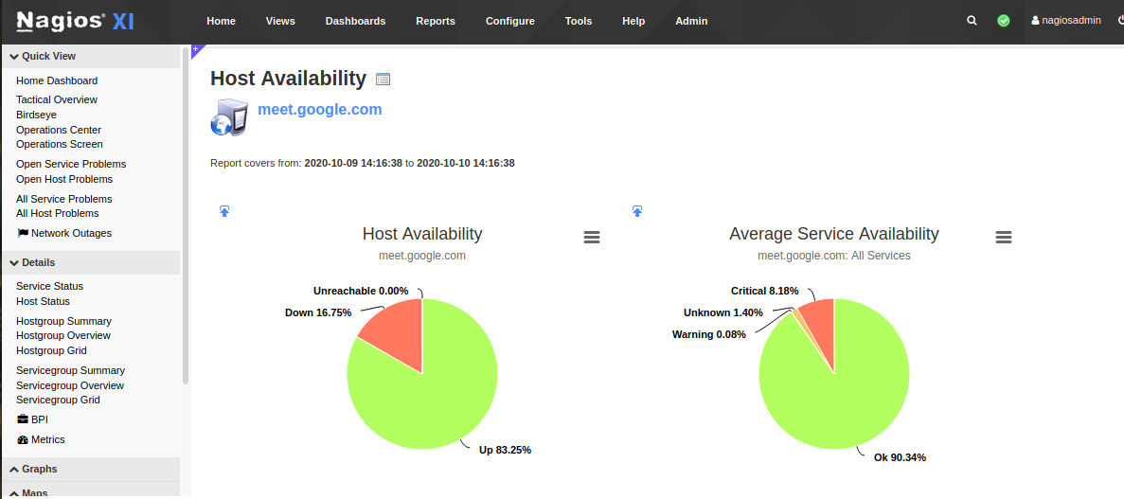

Slide 45
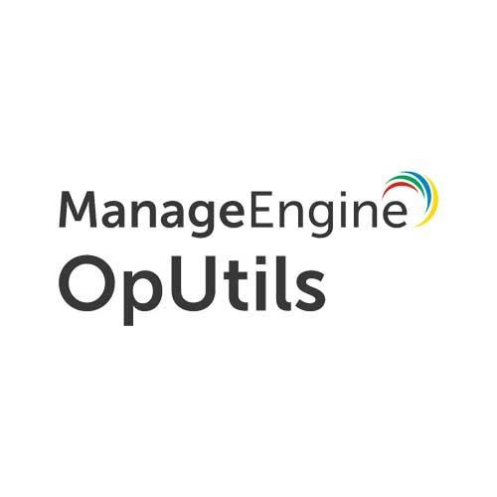
OpUtils
Efficient IP address and Switch port management software.
Detects rogue device intrusion.
Consists of other tools that help in bandwidth usage monitoring, taking backup of configuration files and address resolvers.
By ManageEngine

Slide 46
Installation:
Linux Installation:
Assign the executable permission to the downloaded file using the following command: chmod a+x OpUtils.bin
Execute ./OpUtils.bin with administrator privileges (sudo). The installation wizard pops up.
Windows Installation:
Download .exe file from the link and execute the file. An installation wizard pops up.
Select appropriate networks before proceeding to installation according to requirements in the installation wizard.
The process is similar for both linux and windows from here.

Slide 47
Installation
Click 'Next' to begin the installation process. Go through the license agreement and proceed to the next step.
In the subsequent steps of the wizard, select the OpUtils Edition (Professional or Free), language, the directory to install OpUtils, and the port number to run OpUtils Web Server. Proceed to the next step.
Verify the installation details and click 'Next'.
Click Finish to complete the installation process.

Slide 48
Starting OpUtils
Linux:
Go to /OpManager/bin folder
Execute: sh run.sh
Open browser and go to the url stated in the terminal (device-name:8060)
Login with the default credentials for the first time.
Windows:
Connect to the front end of OpUtils on your web browser with device-name:8060

Slide 49
Features and Tools
IP address management
Switch port management
Rogue device detection
Bandwidth monitor
Config file manager
Wake-on Lan tool
SNMP tools
CISCO tools
Diagnostic tools
Network Monitoring tools
Address Monitoring tools
Network tools

Slide 50
IP Address Management
It provides a centralized IP management to all the networked devices i.e scans all IPv4 and Ipv6 addresses.
Provides real time visibility and control on IP addresses in the network.
Keeps track of all related IP address details.
It allows users to define a hierarchy to add all subnets based on their usage/location and scan them. Addition can be done in two ways -
Manual addition
Bulk addition

Slide 51
Switch Port Management
Identify switch ports connected to a device.
Scan all the switches in the network and map the switch ports to devices down to its physical location.
View operational status and speed of each port.
Automatically collects the MAC, IP and DNS details.
Switch addition can be done in two ways -
Manual Addition
Bulk addition

Slide 52
Rogue device detection
Detect unauthorized access of network resources.
Periodically scans routers and subnets.
Ability to mark devices as trusted , guest and rogue.
Alerts when status of device changes.

Slide 53
Comparison of Tools

Slide 54
Tool / Feature | Colasoft Capsa | ntopng (community version) | Nagios
Type | Packet Analyzer | Network Analyzer | Network Monitoring
Open source | No | Yes | Yes
Web interface | Yes | Yes | Yes
Supporting platforms | Windows | Windows, Debian, MacOS, Raspberry Raspbian. | Windows with VM or Hyper-V,Linux
Traffic analysis & Bandwidth monitoring | Yes | Yes | Yes
Application monitoring & Network protocol analysis | Yes | Yes | No

Slide 55
Tool / Feature | Colasoft Capsa | ntopng (community version) | Nagios
Triggers / Alerts | Yes | Yes | Yes
VoIP analysis | Yes | No | No
Data Storage Method | Oracle | MySQL, ElasticSearch and LogStash | MySQL
Protocol Support | IP, TCP, HTTP,UDP, ICMP and many more | Ethernet, IPv4/IPv6, TCP, UDP, DHCP and many more | HTTP, FTP, SMTP, SNMP, POP3, SSH and MySQL
Network Troubleshooting | Yes | Yes | Yes
Integration | Possible | Possible | Possible
Latest release version & date | Capsa edition 13, Feb 26, 2020 | ntopng 3.2 Dec 4, 2017 | Nagios Core 4.4. 6 2020-04-28.

